Slide 1

Topic Modeling and Sentiment Analysis of UN Speeches
A Historical and Geographic Analysis
Sam Cohen
Notes:
Hi all,
For my final project, I thought it would be fun to do some topic modeling on UN speeches. I also wanted to compare my findings with general sentiment, and validate my findings with historical and geographic trends.

Slide 2
Agenda
Background & Motivation
Data
Methodology
Results
Conclusion

Slide 3
Background & Motivation

Slide 4
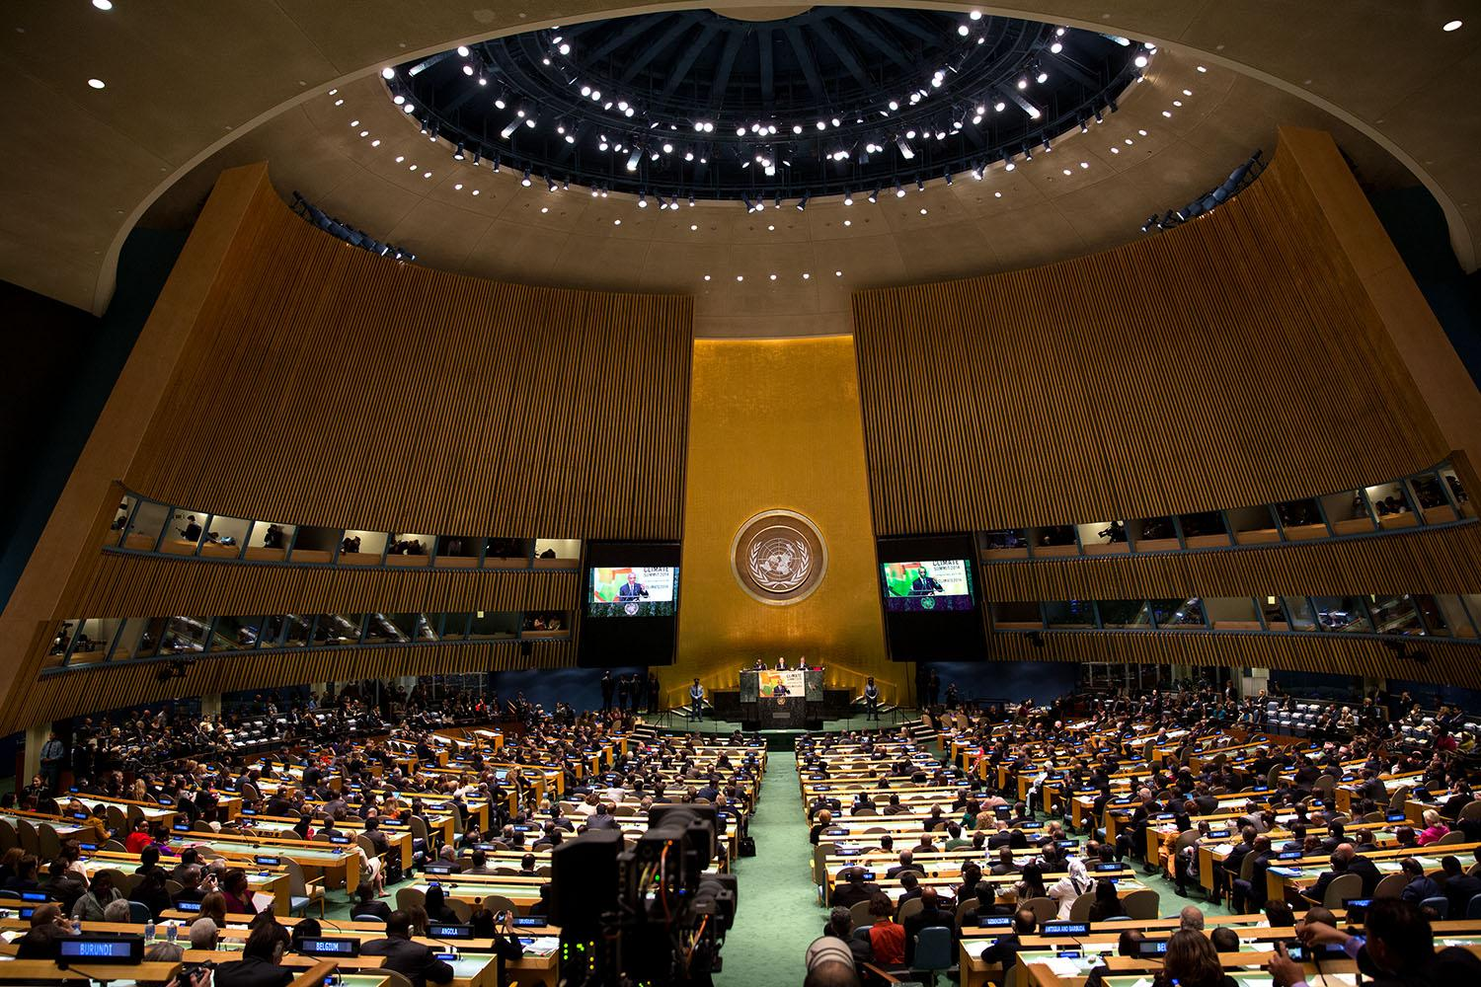
Background & Motivation
UN composed of 6 bodies:
Security Council
General Assembly
Economic and Social Council
Trusteeship Council
International Court of Justice
Secretariat
General Assembly (UNGA): UN body composed of all 193 member states
Member nations discuss international matters and the state of the world at yearly debates
What do these speeches tell us?
Notes:
Im sure you are all aware of the UN, so I go into too much detail. But the UN is composed of 6 bodies, one of which is the General Assembly (UNGA).
Unlike the Security Council that makes binding decisions and is composed of only 15 members (5 of which are permanent), the General Assembly is a relatively ceremonial body that includes representatives from all of the UN’s 193 member states.
It is a place for them to discuss the state of the world, which they do every year at the UNGA general assembly debate

Slide 5
Background & Motivation
Research questions:
What topics exist in the speeches at the UN debates? What is the sentiment of these speeches?
How do sentiment and topics change over time and between countries?
What is the relationship between sentiment and world metrics?
Can results be validated with real-world events?
Notes:
I wanted to explore what themes emerged in these speeches. I ask the following questions:
What topics exist in the speeches at the UN debates? What is the sentiment of these speeches?
How do sentiment and topics change over time and between countries?
What is the relationship between sentiment and world metrics?
Can results be validated with real-world historical events?

Slide 6
Data

Slide 7
Data
UN General Debate Corpus, 1946-2023
10,760 speeches at the country-year level (e.g. “USA - 1990”)
Additional variables included: regime type, major power, democracy, gender equality score
Average speech length: 2,930 words
World Development Indicators
GINI, GDP per capita at the country-year level
Merged to UN data by country-year
Notes:
My data comes from the UN General Debate Corpus, which contains UNGA debate speeches from 1946 to 2023.
It is structured at the country-year level, with each country delivering their speech every year.
The dataset I’m using also contains variables on regime type (i.e. authoritarian, democracy, hybrid, etc.), whether or not the country is a major power, democracy score, and a gender equality score.
The average length of each speech was just under 3000 words, which for context is roughly 10 pages and 15 minutes long.
I also wanted to do some analysis on further metrics, so I merged GINI coefficient and GDP per capita data onto the original data frame at the country-year level. This data came from the world bank’s World Development Indicators API.

Slide 8
Methodology

Slide 9


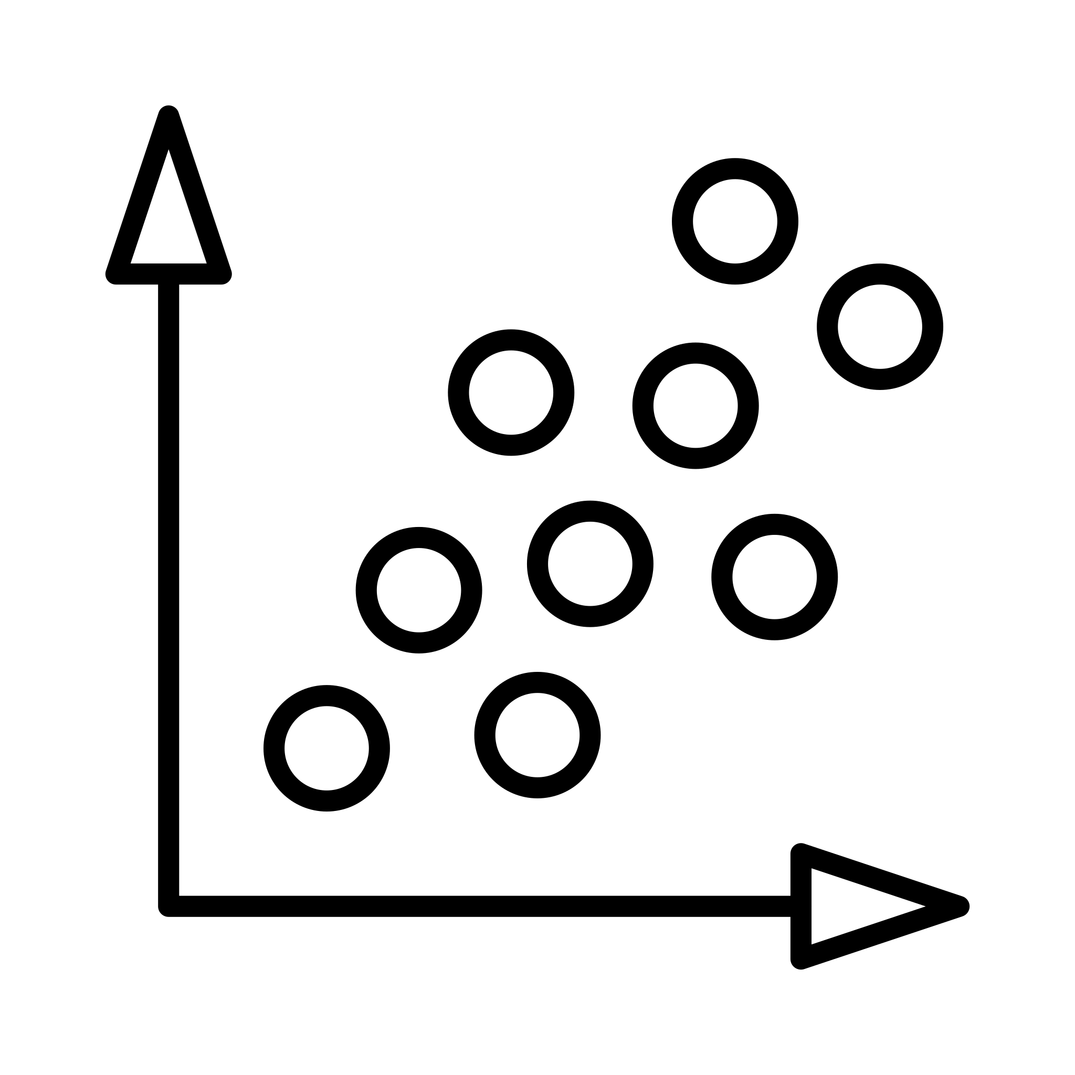

Methodology
Topic modeling: Latent Dirichlet Allocation (LDA)
Sentiment Analysis: Lexicoder Sentiment Dictionary (LSD)
Hypothesis testing: Regression analysis
Dashboard: R Shiny
Notes:
Once I had all my data compiled, I did my topic modeling. I used LDA. After observing perplexity scores for different values of K, I opted for K=10. I used the “Gibbs” method as well. I then observed the top terms and assigned topic names as necessary– I validated by looking at the speech itself, but also looking at trends (I’ll get to that in the dashboard).
To get the sentiment for each speech, I used LSD. This was because LSD is specifically used a lot for political text, and that VADER is best suited for shorter text like tweets. It’s also much less computationally expensive.
Once I had all of these values, ran regressions to see how different metrics affect sentiment.
Finally, I created a dashboard to observe the different combinations of speech topics, sentiment, and metrics.

Slide 10
Results

Slide 11
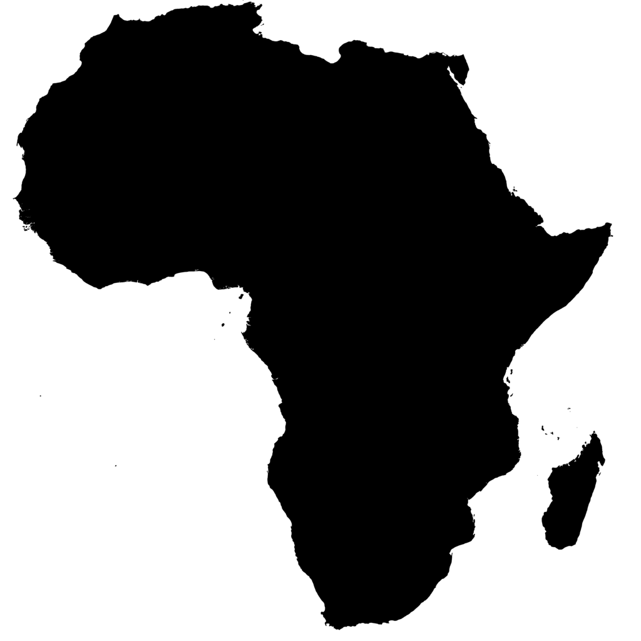
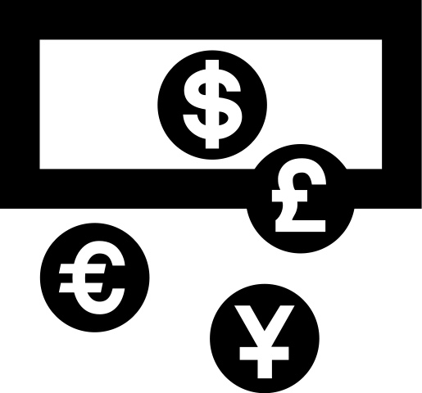
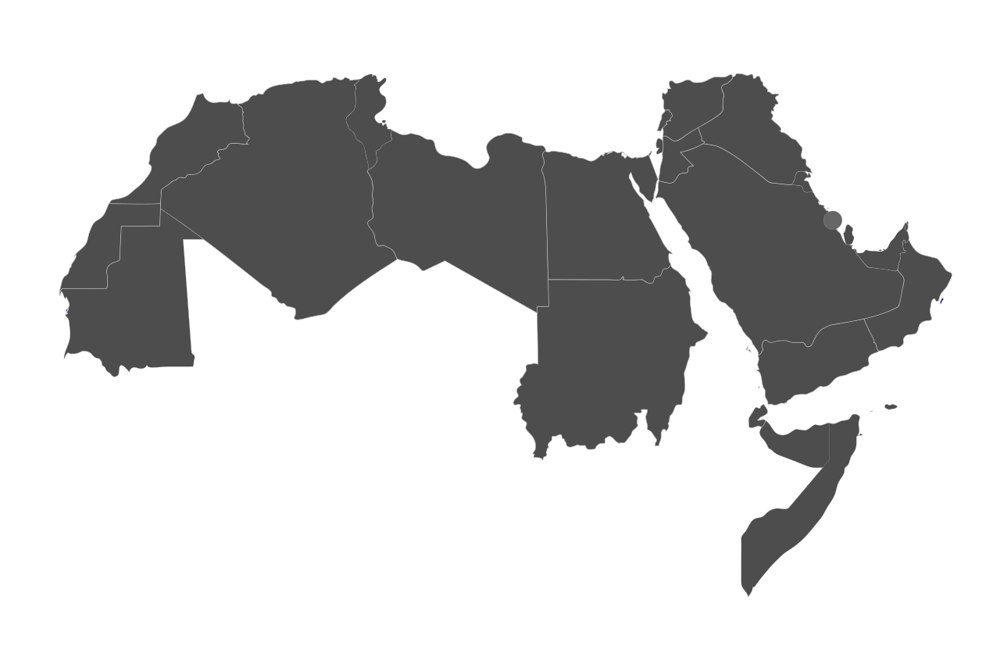







International Development & Economic Inequality
Africa & The Global South
The Middle East
War, Conflict, & Diplomacy
Peacebuilding & Disarmament
Climate, Sustainability, & Development Goals
Peacekeeping Operations
The Cold War
Island Nations
International Cooperation
10 Topics
“countri, intern, econom”
“africa, african, peopl, south”
“intern, peace, secur, Arab, Israel”
“world, must, war”
“intern, world, peace, nuclear”
“global, develop, climat, sustain”
“unit, power, organ, govern, charter”
“peace, war, soviet, forc”
“develop, nation, island”
“unit, intern, secur, council, cooper”
Notes:
These were the results of the LDA. Generally, topics were pretty well delineated. Under each topic, you can find some of the top words with the highest betas associated with each topic.
I thought about combining some of these (like war conflict and diplomacy, and peacekeeping), but decided to keep them separate because they do have differences.

Slide 12
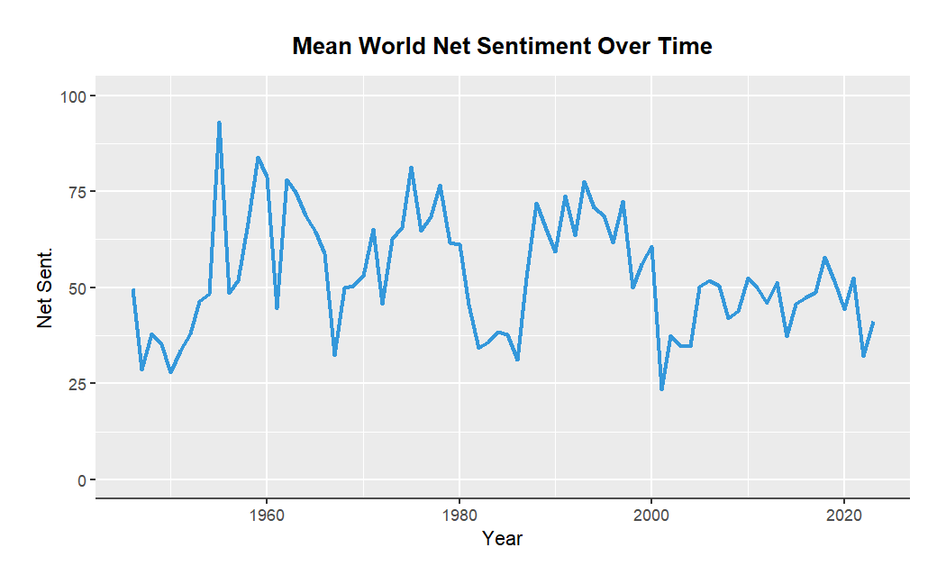
Sentiment Analysis Results
Sentiment generally stays above 0, with mean of ~50
Highest mean net sentiment: “Peacebuilding & Disarmament”
Lowest mean net sentiment:
“The Cold War”
Notes:
Sentiment varies a lot, but is generally above 0. The mean speech sentiment was around 53, with the minimum being around -200 and the max being around 400.
The graphic here just shows the mean world sentiment by year over time. It is not very helpful at first glance, but once we break sentiment down by country and topic it makes a lot more sense, which I’ll show in the dashboard.
The topic with the highest average sentiment is Peacebuilding and Disarmament.
The topic with the lowest average sentiment is The Cold War

Slide 13
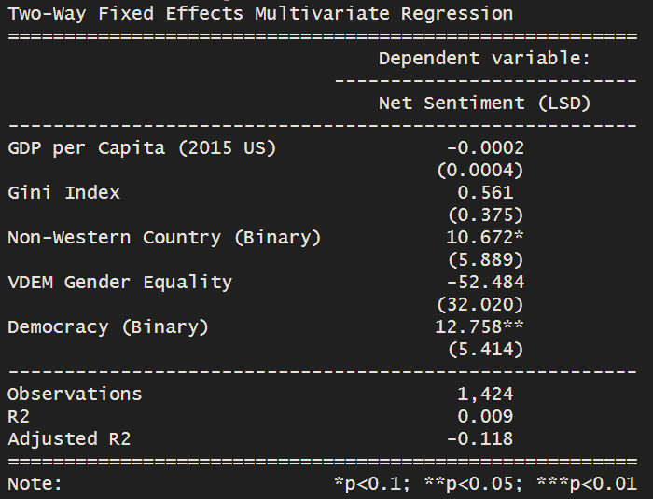
Hypothesis Testing
Multivariate fixed-effects regression
Dependent variable: LSD Sentiment
Democracy (binary) only statistically significant relationship
Notes:
Because of the country-year structure of the data, a standard multivariate regression wouldnt be that insightful.
I therefore went with a two-way fixed effects multivariate model.
I included the variables for GDP per capita, Gini, non-western, gender score, and a democracy dummy variable.
Interestingly, the only statistically significant coefficient was for the democracy dummy variable– democracies had sentiment scores almost 13 points higher than non-democracies.

Slide 14
Dashboard
Demo

Slide 15
Conclusion

Slide 16
Conclusion: Lessons Learned & Next Steps
Speeches generally fell into specific categories well (but not perfect)
Certain aspects of sentiment and topics validated by historical events and geography
Most metrics not indicative of sentiment
Next steps and possible additions:
Different / higher K
Different topic modeling methods (STM)
TFIDF and n-gram analysis
Word scaling
Notes:
So what did I learn?
Generally, speeches fell pretty well into the assigned topic model categories. But obviously this was not perfect– for example, there were some countries that gave speeches classified as “Island Nation” speeches that weren’t island nations.
Certain aspects of sentiment and topics were indeed validated by temporal trends and geographic analysis. This was promising and one of the main goals of this project.
Regarding the regression, most world metrics were not indicative of UN speech sentiment.
In terms of next steps and improvements:
Given more time and computational power, a higher K during LDA would yield more topics and then I could consolidate them for more accurate results.
Also looking at different topic models like STM to see if there are any differences and improvements
Finally, things like TFIDF, word scaling, and creating classifiers could be interesting

Slide 17
References
https://www.andrewheiss.com/blog/2021/12/01/multilevel-models-panel-data-guide/
https://www.kaggle.com/datasets/namigabbasov/united-nations-general-debate-corpus-1946-2023?resource=download
https://www.un.org/en/about-us/main-bodies
https://www.pbs.org/newshour/world/what-is-the-un-general-assembly-and-what-does-it-do
https://www.snsoroka.com/data-lexicoder

